Slide 1

MEMBERS
Day, Date
Jeet
Prem
vrutika
keyursinh
TEAM NAME
Saturday, 26-Aug
Bit-Tech
Problem Statement :
Efficient Container Placement System (ECPS) : AI Based solution

Slide 2

Problems
Space Optimisation
Time Complexity
Load Balancing

Slide 3

Purpose of the Project
Increase Efficiency
Decrease Manual Labour
Time-efficiency
Reduce Resource waste

Slide 4

Target Audience
Ports
Container Rail Terminals
Container Management companies

Slide 5

Basic Features
Simple UI/UX
Android app
compatible with any device

Slide 6
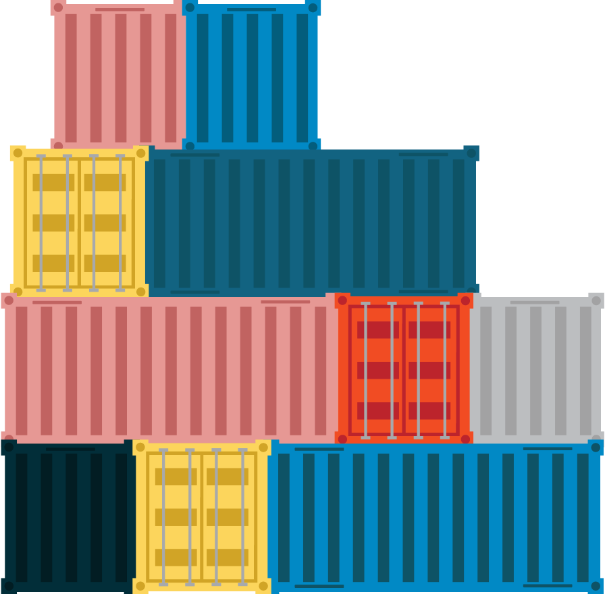
How We Assign Location Of A Container
We First collect Data by Excel file.
Then we analyse and process the data.
Then we assign A efficient -location based on ML.

Slide 7
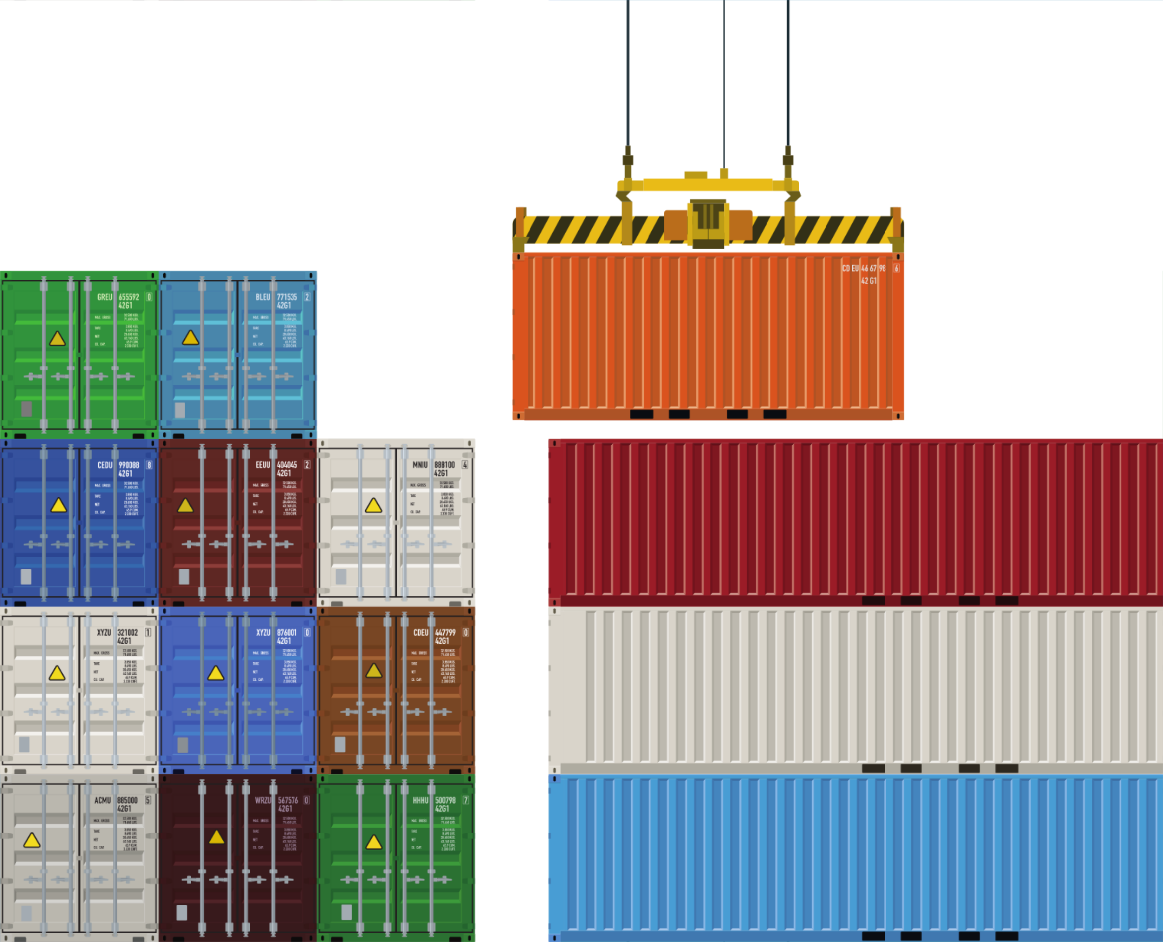
Real World Impact of ECPS
Cost savings
Increased efficiency
Resource utilization
Improved safety
Enhanced customer satisfaction

Slide 8

ECPS Business Model
: Provide container placement optimization software.
: Generate income through licensing, subscriptions, and customization services.
: Enhance efficiency, reduce costs, and ensure compliance for shipping companies and port operators.
: Distribute software online via website or app, and utilize sales teams for direct outreach.
Service
Revenue
Value
Channels

Slide 9


